Slide 1
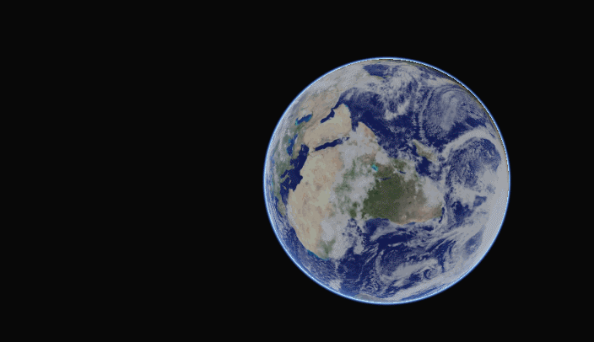
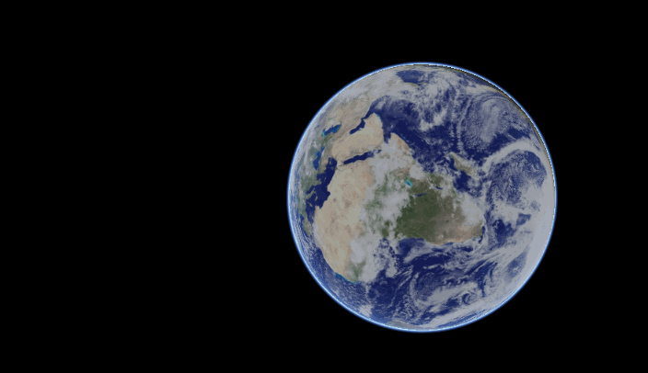
RENDERING ATMOSPHERIC LIGHT SCATTERING
V1.0 Single Scattering
TFG - Gustavo Raush Faggembauu
LaSalle URL
2017-2018

Slide 2

OUTLINE
INTRODUCTION
BASICS
SCATERRING THEORY
CAVEATS OF NAIVE IMPLEMENTATION
ACTUAL IMPLEMENTATION
DEMO
CONCLUSIONS AND FUTURE WORK
REFERENCES

Slide 3
OUTLINE
INTRODUCTION
BASICS
SCATERRING THEORY
CAVEATS OF NAIVE IMPLEMENTATION
ACTUAL IMPLEMENTATION
DEMO
CONCLUSIONS AND FUTURE WORK
REFERENCES

Slide 4


Who am I?
Multimedia Engineering student
Intership at Cl3ver, 1 year and 5 months
TFG at atmospheric light scattering
Interested in Computer Graphics (mostly real time)

Slide 5
OUTLINE
INTRODUCTION
BASICS
Introduction – Atmospheric Light Scattering
How we will compute it?
The midpoint rule
SCATERRING THEORY
CAVEATS OF NAIVE IMPLEMENTATION
ACTUAL IMPLEMENTATION
DEMO
CONCLUSIONS AND FUTURE WORK
REFERENCES

Slide 6
Introduction – Atmospheric Light Scattering
Difficult problem but very important for outdoor environments rendering
Difficult complex equations, hard to achieve real time
Real-Time algorithm running on GPU using methods described by Nishita et al. 1993. [REF1]
Paper done by Sean O’Neil, described at Nvidia GPU Gems2 [REF2]

Slide 7
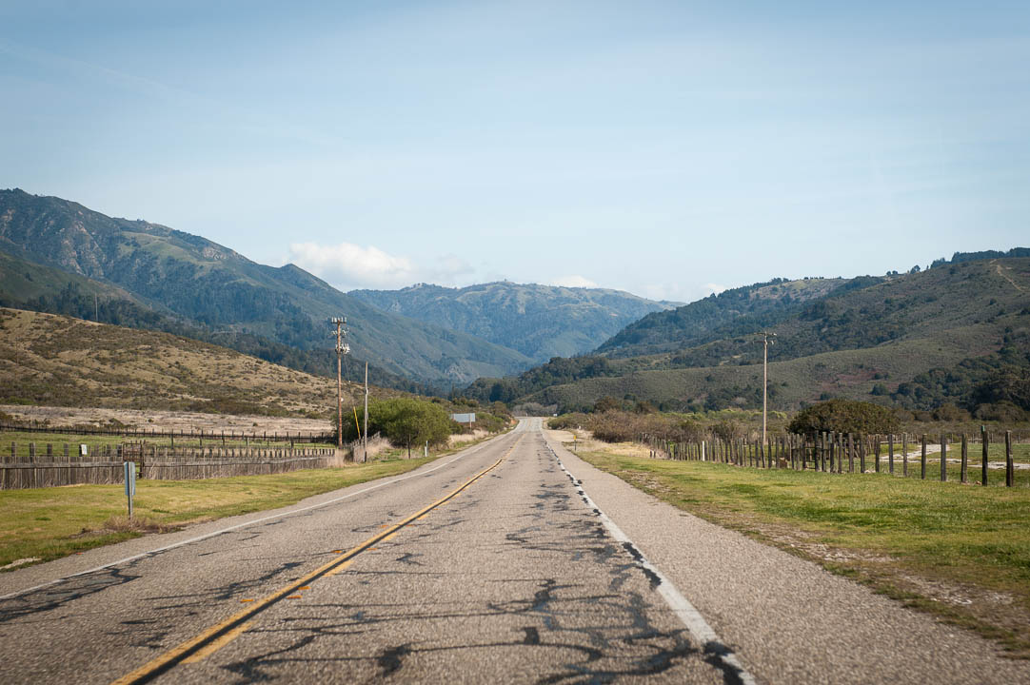
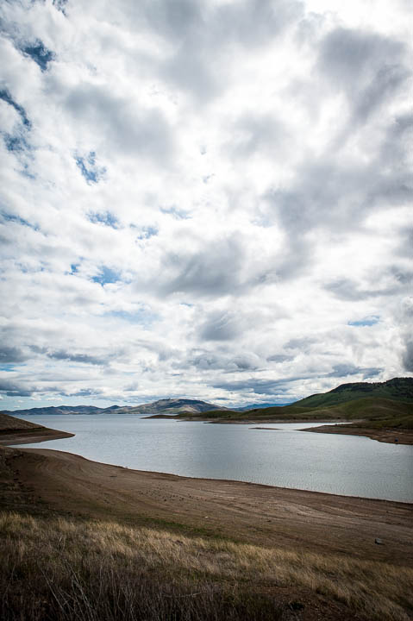
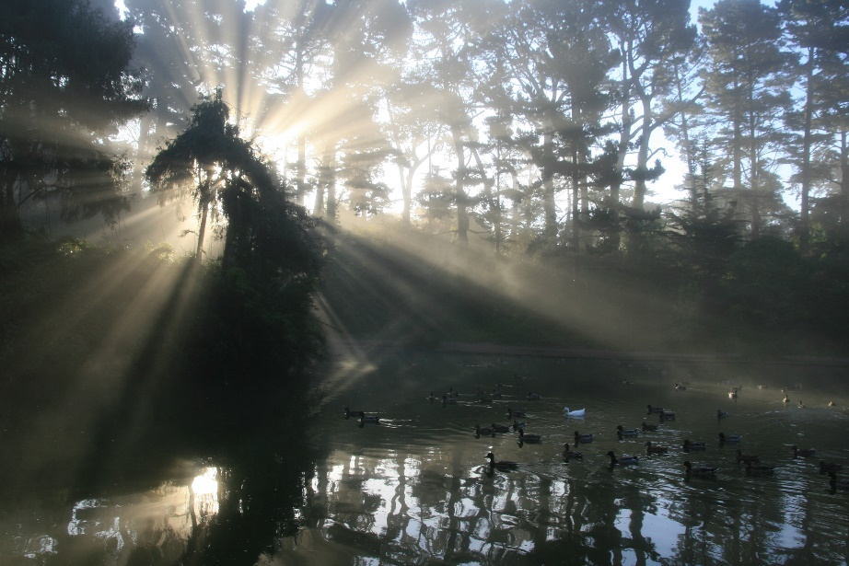
Atmospheric Scattering
Sky color
Fog
Clouds
“God rays”
Light shafts
Volumetric shadows
Notes:
So, why do we need atmospheric scattering simulation?
It is physical effect responsible for many visual elements of visible world, such as sky color, fog, clouds, god rays, light shafts, volumetric shadows or even smoke.

Slide 8
Atmospheric Light Scattering
Atmosphere scatters light
Responsible for the sky color
Caused by a variery of particles
- Molecules, dust, water vapor, etc.
Illuminates the sky
Attenuates and colors the Sun
Attenuates and colors distant objects (aerial perspective)

Slide 9
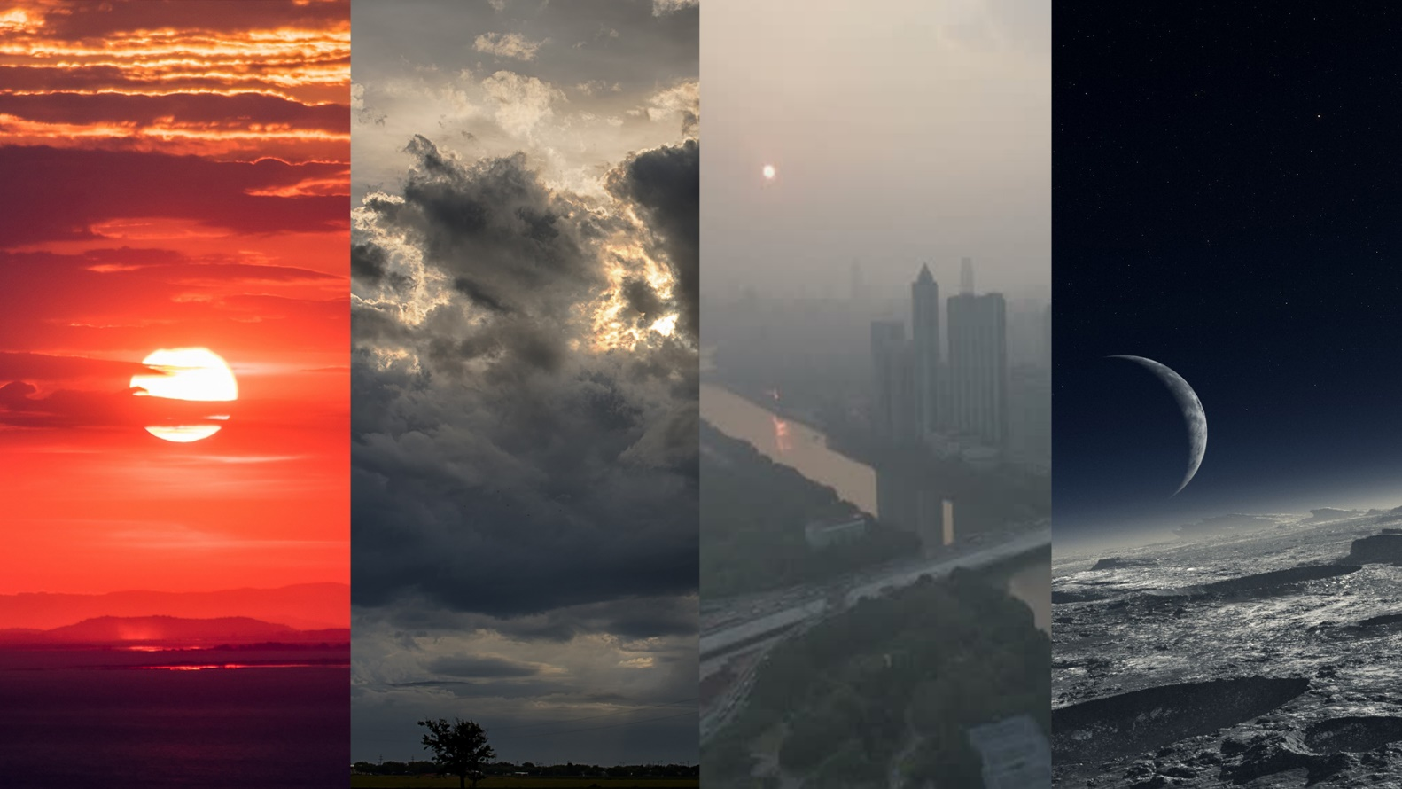
Atmospheric Light Scattering
Varies by
- Time of day
- Weather
- Pollution
- Planet atmosphere

Slide 10
How we will compute it? (1)
We have a ray from the camera through the atmosphere to a vertex
Vertex can be part of terrain, part of sky dome, part of cloud or object in space
If ray passes through atmosphere scattering needs to be calculated
A ray has two points defined, where starts passing through atmosphere and where it stops. A and B respectively
Depends on the situation we have to do a sphere-check intersection to find the point. (camera in space; or camera in atmosphere)

Slide 11
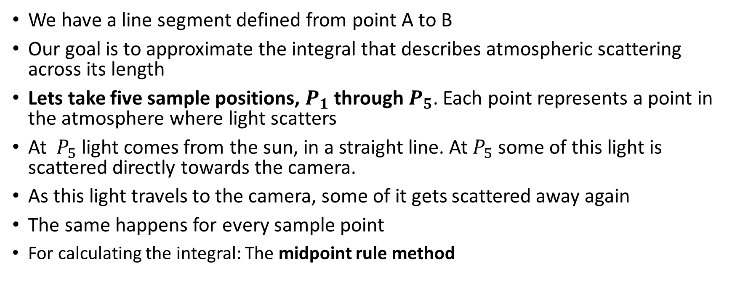
How we will compute it? (2)
We have a line segment defined from point A to B
Our goal is to approximate the integral that describes atmospheric scattering across its length
Lets take five sample positions, $P_{1}$ through $P_{5}$. Each point represents a point in the atmosphere where light scatters
At $P_{5}$ light comes from the sun, in a straight line. At $P_{5}$ some of this light is scattered directly towards the camera.
As this light travels to the camera, some of it gets scattered away again
The same happens for every sample point
For calculating the integral: The midpoint rule method
Notes:
Now we have a line segment defined from point A to point B, and we want to approximate the integral that describes the atmospheric scattering across its length. For now let's take five sample positions and name their points P ₁ through P ₅. Each point P ₁ through P ₅ represents a point in the atmosphere at which light scatters; light comes into the atmosphere from the sun, scatters at that point, and is reflected toward the camera. Consider the point P ₅, for example. Sunlight goes directly from the sun to P ₅ in a straight line. Along that line the atmosphere scatters some of the light away from P ₅. At P ₅, some of this light is scattered directly toward the camera. As the light from P ₅ travels to the camera, some of it gets scattered away again.

Slide 12
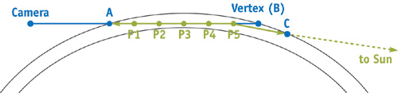
How we will compute it? (3)
Notes:
We have a ray from the camera through the atmosphere to a vertex
Vertex can be part of terrain, part of sky dome, part of cloud or object in space
If ray passes through atmosphere scattering needs to be calculated
A ray has two points defined, where starts passing through atmosphere and where it stops. A and B respectively
Depends on the situation we have to do a sphere-check intersection to find the point. (camera in space; or camera in atmosphere)

Slide 13
The midpoint rule
-Method for approximating a definite integral
-Weighted sum calculated in a loop
MIDPOINT RULE:
- Definite integral
- Break definite integral into n segments
- Evaluate integral at center of each segment
- Multiply each result by length of segment
- Add them up
-PROFIT!

Slide 14
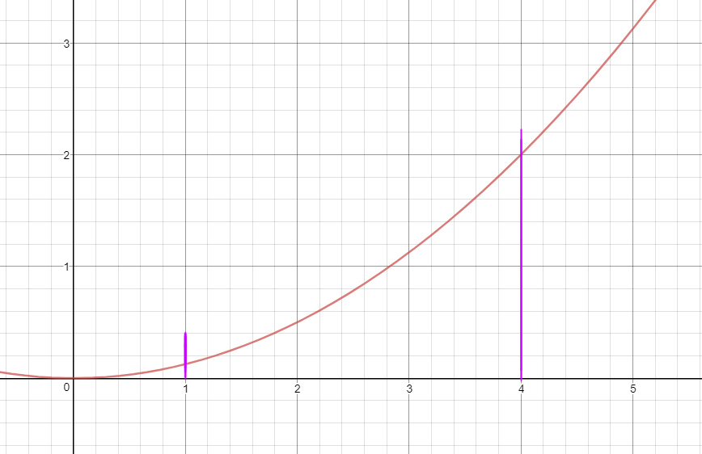
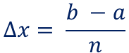
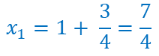
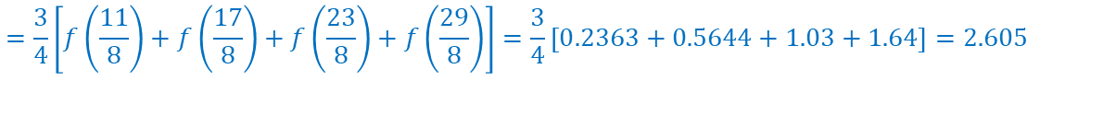
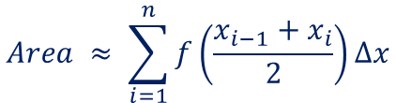
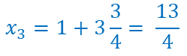
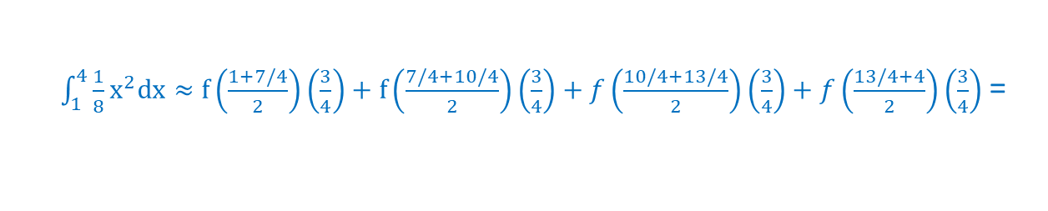
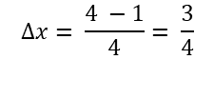
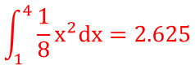
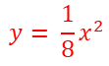
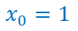
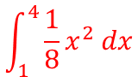
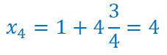
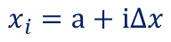
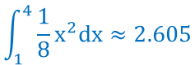
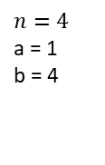
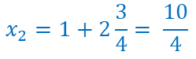
The midpoint rule
-EXAMPLE
$$\int_{1}^{4}{\frac{1}{8}x^{2} dx}$$
Use the Midpoint rule with n = 4 to approximate the definite integral
The Midpoint Rule
$$Area ≈ \sum_{i=1}^{n}{f\left(\frac{x_{i−1}+x_{i}}{2}\right)∆x}$$
$$∆x= \frac{b −a}{n}$$
$$x_{i}=a+i∆x$$
$$y= \frac{1}{8}x^{2}$$
$$n=4$$
a = 1
b = 4
$$x_{1}=1+ \frac{3}{4}=\frac{7}{4}$$
$$x_{2}=1+2\frac{3}{4}= \frac{10}{4}$$
$$∆x= \frac{4 −1}{4}= \frac{3}{4}$$
$$x_{0}=1$$
$$x_{3}=1+3\frac{3}{4}= \frac{13}{4}$$
$$x_{4}=1+4\frac{3}{4}=4$$
$\int_{1}^{4}{\frac{1}{8}x^{2}dx≈f\left(\frac{1+7/4}{2}\right)}\left(\frac{3}{4}\right)+f\left(\frac{7/4+10/4}{2}\right)\left(\frac{3}{4}\right)+f\left(\frac{10/4+13/4}{2}\right)\left(\frac{3}{4}\right)+f\left(\frac{13/4+4}{2}\right)\left(\frac{3}{4}\right)$=
$$=\frac{3}{4}\left[f\left(\frac{11}{8}\right)+f\left(\frac{17}{8}\right)+f\left(\frac{23}{8}\right)+f\left(\frac{29}{8}\right)\right]=\frac{3}{4}\left[0.2363+0.5644+1.03+1.64\right]=2.605$$
$$\int_{1}^{4}{\frac{1}{8}x^{2}dx≈2.605}$$
$$\int_{1}^{4}{\frac{1}{8}x^{2}dx=2.625}$$

Slide 15
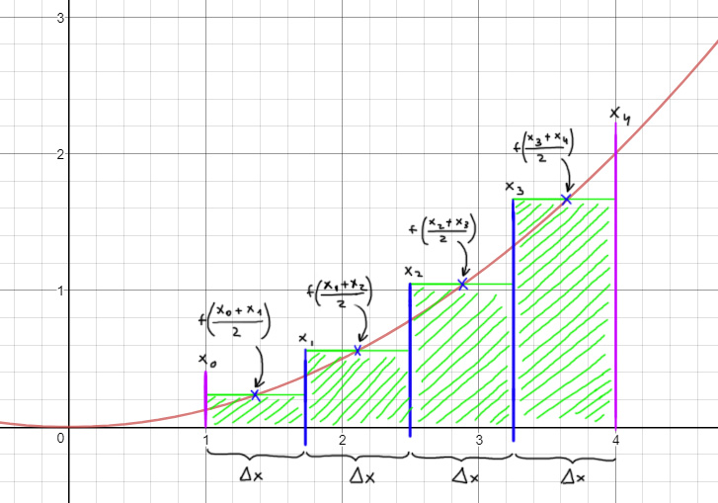
The midpoint rule
$$y= \frac{1}{8}x^{2}$$

Slide 16
OUTLINE
BASICS
SCATTERING THEORY
Scattering principles
Rayleigh and Mie Scattering
The Phase Function
The Out-Scattering Equation
The In-Scattering Equation
CAVEATS OF NAIVE IMPLEMENTATION
ACTUAL IMPLEMENTATION
DEMO
CONCLUSIONS AND FUTURE WORK
REFERENCES

Slide 17
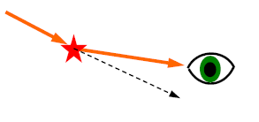
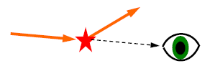
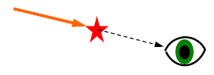
Scattering events at each sample:
Light scattered into the line of sight (in-scattering)
Light scattered out of the line of sight (out-scattering)
Light absorbed altogether (absortion)

Slide 18
Scattering Principles. Atmospheric scattering
Out-scattering
Incoming light
Transmission
Absorbtion
$$L_{incoming}=L_{transmitted}+L_{absorbed}+L_{scattered}$$
Notes:
Phenomenon of atmospheric scattering is caused by interaction of photons with particles that form any transporting media. When light traverses any medium that isn’t void, photons/light rays may collide with particles that create such medium. On collision, they may collide and either be diffused or absorbed (and turned into thermal energy). In optics, such process is usually modelled statistically and we can define amount of energy that takes part in following processes:
• Transmittance
• Scattering
• Absorbtion
As energy is always conserved, we can write that:
Lincoming = Ltransmitted + Labsorbed + Lscattered

Slide 19



Scattering Principles. No scattering
Notes:
No light scattering / non-participating transport media
We assume that the transport media behaves like vacuum – there is no radiance loss or gain on light paths between objects.
Typical rendering scenario – light from the light source bounces from one object to another according to the surface BRDF functions, finally reaching camera/eye.
Simplest possible case is no bounced light/GI, just direct lighting.

Slide 20



Scattering Principles. Light Scattering
In-scattering
Out-scattering
Notes:
When media participates in light transport, every particle large enough to affect photons/light rays takes part in the light transport equation.
For example dust or water particles make some light rays / photons bounce in random directions, making some light enter the light path (in-scattering).
While on the other hand also some light gets bounced away, exiting the light path and becoming darker (out-scattering).
Obviously, in reality this is very complex as every particle both out-scatters and in-scatters some light according to phase functions, so multiple rays exit and enter the light path multiple times, but usually in real-time rendering we have to ignore multiple scattering.

Slide 21


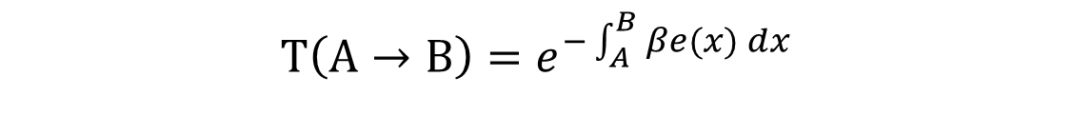
Scattering Principles. Beer-Lambert Law
$$T\left(A→B\right)=e^{−\int_{A}^{B}{βe(x)} dx}$$
Notes:
Physical law that is very useful for light scattering calculations is Beer-Lambert law that describes extinction of incoming lighting (light out-scattering). This law defines value of transmittance (proportion of light transported through medium to incoming light from given direction). It is defined usually as:
$$T\left(A→B\right)=e^{−\int_{A}^{B}{βe(x)} dx}$$
Symbol $βe$ is extinction coefficient, defined as sum of scattering and absorption coefficients. We can see from Beer-Lambert law that light extinction is exponential function of travelled distance by light in given medium.

Slide 22
Rayleigh and Mie Scaterring
Different particles scatter light in diferent ways.
Most comon types of scatering: Rayleigh and Mie scattering
Anisotropic out-scattering
Mie scattering
Incoming light
Transmission
Absorbtion
Isotropic out-scattering
Rayleigh scattering
Incoming light
Transmission
Out-scattering
Notes:
Depending on the medium particles, amount of light that takes part in those processes can be different. One example of scattering models is Rayleigh scattering. It is scattering of very small particles (like air particles), responsible for blue color of the sky. It is very isotropic, uniform, but wavelength dependent – scattering is stronger for shorter wavelengths and absorption is negligible.
On the other hand, so called Mie scattering of bigger particles (like aerosols or dust) has very anisotropic shape with strong forward lobe and much higher absorption proportion.

Slide 23
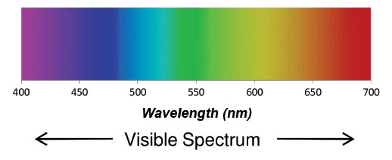
Rayleigh Scaterring
Caused by small molecules in the air
Scaters more heavily at shorter wavelengths (blue first, then geren and finally red)
Why is the sky blue then? Why is it red at sunset?

Slide 24
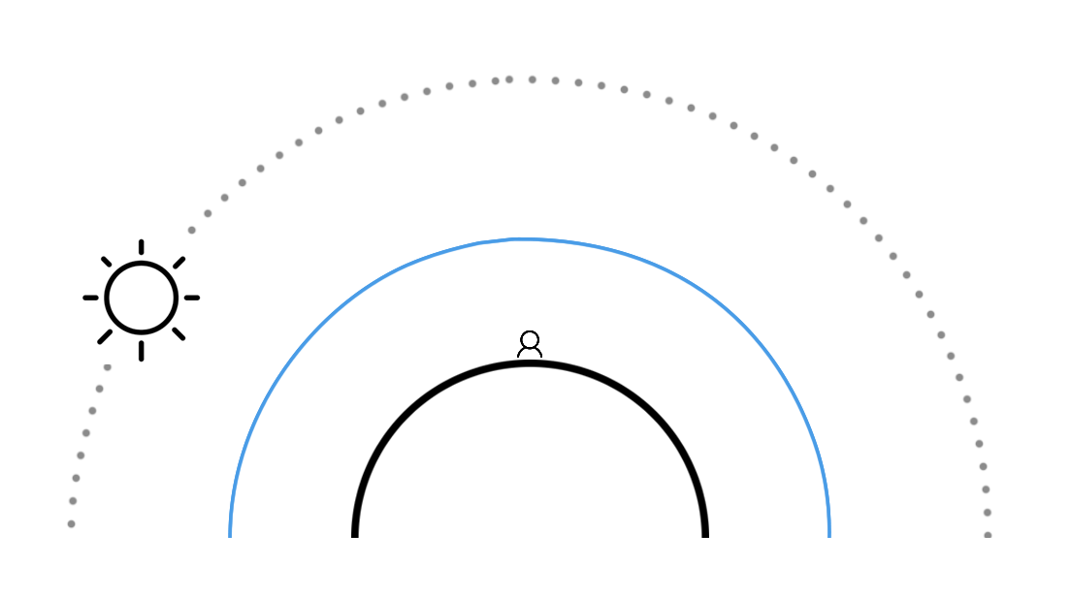
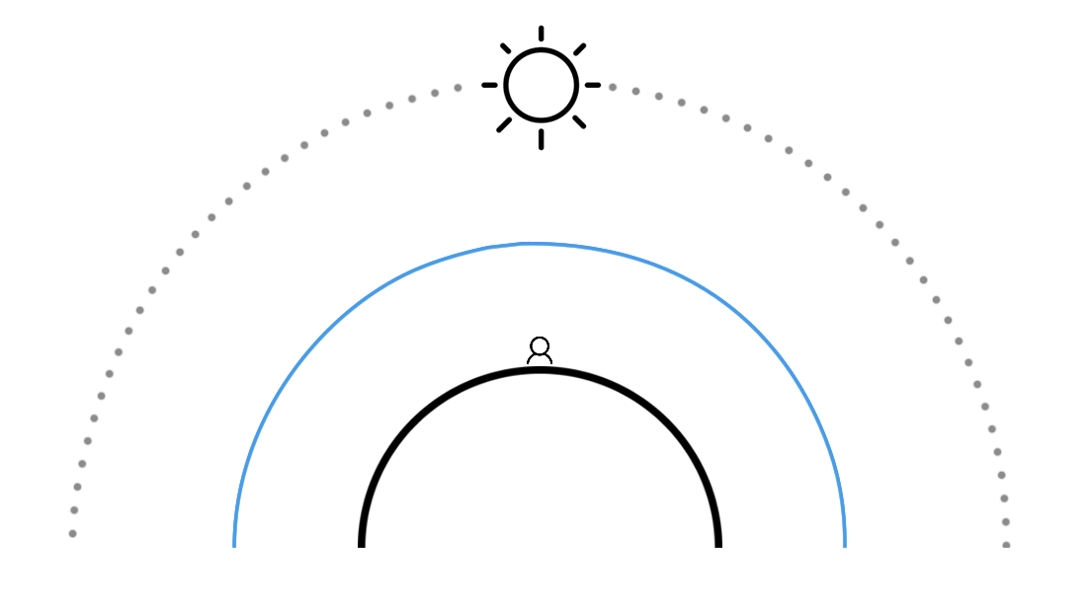
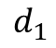
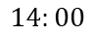
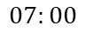
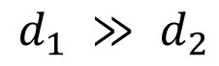
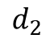
Dawn & dusk
Middle of day
$$14:00$$
$$07:00$$
$$d_{2}$$
$$d_{1}$$
$$d_{1} ≫ d_{2}$$

Slide 25
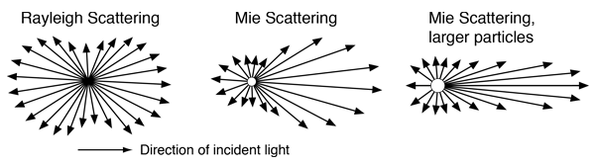
Mie Scaterring
Caused by larger particles called aerosols (such as dust and pollution)
Tends to scatter all wavelengths equally
Highly directional on forward lobe (anisotropic)
High absortion proportion
Produces halo on sun on hazy days

Slide 26
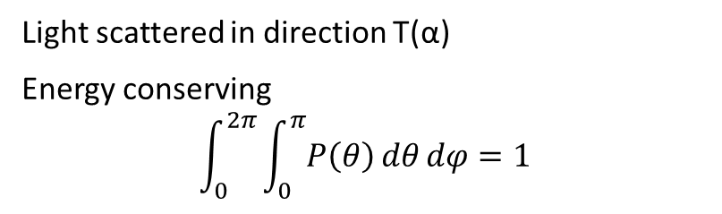
The phase function
Describes how much light is scattered toward all directions, in the analytical version it depends on angle and a constant g (for directionality)
T(α)
α
Phase functions can be very complex
Example: clouds phase function
Source: Bouthors et al, “Real-time realistic illumination and shading of stratiform clouds”
Light scattered in direction T(α)
Energy conserving
$$\int_{0}^{2π}{\int_{0}^{π}{P\left(θ\right)dθdφ}}=1$$
Notes:
Phase function is a function that describes how much light is scattered in all direction. It is a function of angle between the light vector and outgoing direction vectors.
It has property of energy conservation, so integral over all directions must be equal to 1 (or under 1 if it contains information about absorption baked in it).
Some phase functions can be very complex and described from various models or real captured data.

Slide 27
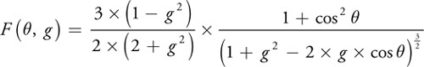
Analytical phase function
Adaptation of the Henyey-Greenstein function used in Nishita et al. 1993.
g is the anisotropy factor, for defining directionality of scattering
$$Rayleigh Scattering: g=0 (Reduces complexity, makes it simetrical)$$
$$Mie Scattering: g=[−0.75, −0.99] (Scatters more light in forward direction)$$
Notes:
The phase function describes how much light is scattered toward the direction of the camera based on the angle (the angle between the two green rays in Figure 16-2) and a constant g that affects the symmetry of the scattering. There are many different versions of the phase function. This one is an adaptation of the Henyey-Greenstein function used in Nishita et al. 1993.
Rayleigh scattering can be approximated by setting g to 0, which greatly simplifies the equation and makes it symmetrical for positive and negative angles. Negative values of g scatter more light in a forward direction, and positive values of g scatter more light back toward the light source. For Mie aerosol scattering, g is usually set between -0.75 and -0.999. Never set g to 1 or -1, as it makes the equation reduce to 0.

Slide 28
Scattering anisotropy
g = 0
g = 0.9
g = 0.3
Negative g values scatters more light in the forward direction
Positive g values scatter more light toward the light source
Notes:
The phase function describes how much light is scattered toward the direction of the camera based on the angle (the angle between the two green rays in Figure 16-2) and a constant g that affects the symmetry of the scattering. There are many different versions of the phase function. This one is an adaptation of the Henyey-Greenstein function used in Nishita et al. 1993.
Rayleigh scattering can be approximated by setting g to 0, which greatly simplifies the equation and makes it symmetrical for positive and negative angles. Negative values of g scatter more light in a forward direction, and positive values of g scatter more light back toward the light source. For Mie aerosol scattering, g is usually set between -0.75 and -0.999. Never set g to 1 or -1, as it makes the equation reduce to 0.

Slide 29
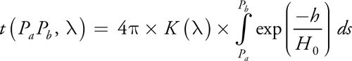
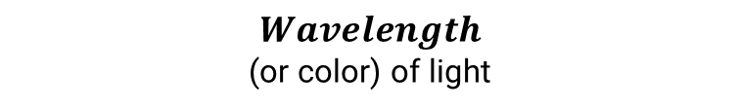
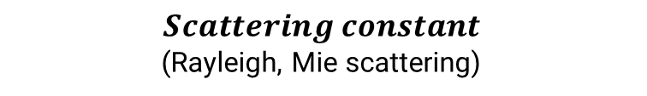
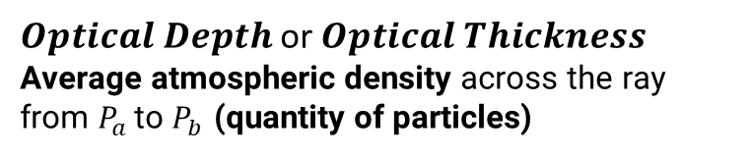
The Out-Scattering equation
Determines how much light gets scattered away from the ray by the particles it passes
$$Wavelength$$
(or color) of light
$$Scattering constant$$
(Rayleigh, Mie scattering)
$Optical Depth$or $Optical Thickness$
Average atmospheric density across the ray from $P_{a }$to $P_{b}$ (quantity of particles)
Notes:
The out-scattering equation is the inner integral mentioned earlier. The integral part determines the "optical depth," or the average atmospheric density across the ray from point P_{a} to point P_{b} multiplied by the length of the ray. This is also called the "optical length" or "optical thickness." Think of it as a weighting factor based on how many air particles are in the path of the light along the ray. The rest of the equation is made up of constants, and they determine how much of the light those particles scatter away from the ray.
The constant is the wavelength (or color) of light and K() is the scattering constant, which is dependent on the density of the atmosphere at sea level. Rayleigh and Mie scattering each have their own scattering constants, including the scale height (H ₀). Rayleigh and Mie scattering also differ in how they depend on wavelength. The Rayleigh scattering constant is usually divided by ⁴. In most computer graphics models, the Mie scattering constant is not dependent on wavelength, but at least one implementation divides it by ^{0.84}. Wherever this equation depends on wavelength, it must be solved separately for each of the three color channels and separately for each type of scattering.

Slide 30
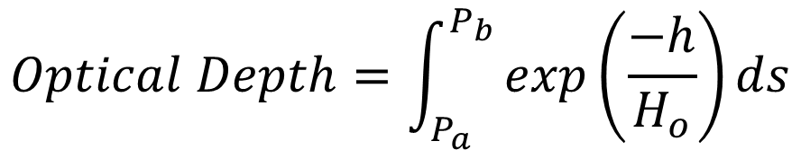
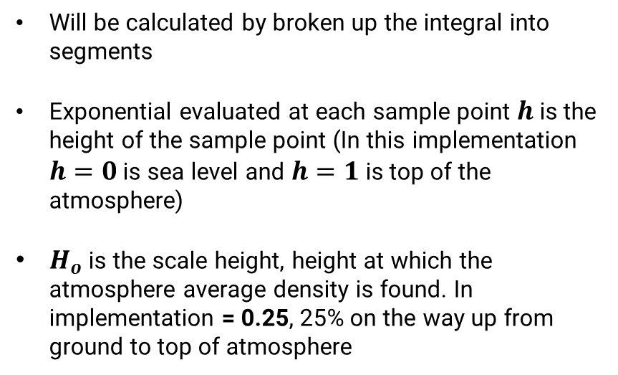
Out-Scattering->Optical Depth. In detail
Think of it as a weighting factor based on how many air particles are in the path of the light along the ray
Will be calculated by broken up the integral into segments
Exponential evaluated at each sample point $h$is the height of the sample point (In this implementation $h=0$ is sea level and $h=1$ is top of the atmosphere)
$H_{o}$ is the scale height, height at which the atmosphere average density is found. In implementation = 0.25, 25% on the way up from ground to top of atmosphere
$$Optical Depth=\int_{P_{a}}^{P_{b}}{exp\left(\frac{−h}{H_{o}}\right)}ds$$
Notes:
To compute the value of this integral, the ray from P_{a} to P_{b} will be broken up into segments and the exponential term will be evaluated at each sample point. The variable h is the height of the sample point. In my implementation, the height is scaled so that 0 represents sea level and 1 is at the top of the atmosphere. In theory, the atmosphere has no fixed top, but for practical purposes, we have to choose some height at which to render the sky dome. H ₀ is the scale height, which is the height at which the atmosphere's average density is found. My implementation uses 0.25, so the average density is found 25 percent of the way up from the ground to the sky dome.

Slide 31
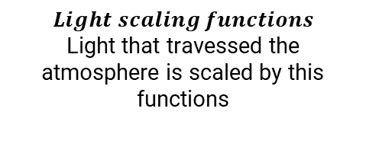
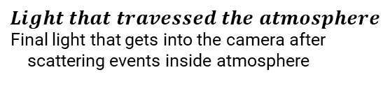
The In-Scaterring equation
Determines how much light is added to a ray through the atmosphere due to light scattering from the sun
Main computation for determining sky colour
$$Light scaling functions$$
Light that travessed the atmosphere is scaled by this functions
$Light that travessed the atmosphere$Final light that gets into the camera after scattering events inside atmosphere

Slide 32
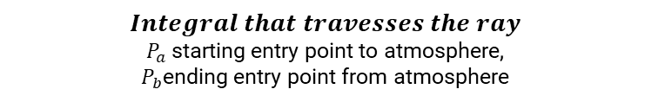






In-Scaterring->Integral. In Detail
$$A$$
$$Integral that travesses the ray$$
$P_{a}$starting entry point to atmosphere,
$P_{b}$ending entry point from atmosphere
$$Transmitance (light outscattering)$$
Proportion of light transported through medium to incoming light from given direction
$$A= \int_{P_{a}}^{P_{b}}{\left(exp\left(\frac{−h}{H_{o}}\right)×exp\left(−t\left(PP_{c}, λ\right)−t\left(PP_{a},λ\right)\right)\right)ds}$$
Light that travessed the armosphere
$$out−scattering point to sun$$
Light scattered out of ray from point to sun
$$Optical Depth$$
Particle density in ray traversing atmosphere
(NESTED INTEGRAL)
$$out−scattering point to camera$$
Light scattered out of ray from point to camera

Slide 33




In-Scaterring->Scaling light. In Detail
$$B$$
$$B= I_{s}\left(λ\right)×K\left(λ\right)×F\left(θ,g\right)$$
$$Sunlight intensity$$
scaling the incoming light by the sun intensity (depending of wavelength for snazzy alien effects)
$$Scattering constant$$
scaling the incoming light by the scattering constants (Rayleigh & Mie)
$$Phase Function$$
Directionality of the final light going to camera

Slide 34







The In-Scaterring equation. Complete
$$Integral that travesses the ray$$
$P_{a}$starting entry point to atmosphere,
$P_{b}$ending entry point from atmosphere
$$Transmitance (light outscattering)$$
Proportion of light transported through medium to incoming light from given direction
$$Phase Function$$
Directionality of the final light going to camera
$$out−scattering point to sun$$
Light scattered out of ray from point to sun
$Sunlight intensity$scaling the incoming light by the sun intensity (depending of wavelength for snazzy alien effects)
$$optical depth$$
Particle density in ray traversing atmosphere
(NESTED INTEGRAL)
$$out−scattering point to camera$$
Light scattered out of ray from point to camera
$$Scattering constant$$
scaling the incoming light by the scattering constants (Rayleigh & Mie)

Slide 35
Visual Representation

Slide 36
OUTLINE
INTRODUCTION
BASICS
SCATERRING THEORY
CAVEATS OF NAIVE IMPLEMENTATION
Naive Implementation
Making it Real Time
ACTUAL IMPLEMENTATION
DEMO
CONCLUSIONS AND FUTURE WORK
REFERENCES

Slide 37

Naive Implementation (1)
For example:
5 sample points in the in-scattering equation
5 sample points for each of the integrals to compute out-scattering equations
$I_{v}\left(λ\right)= I_{s}\left(λ\right)×k\left(λ\right)×F\left(θ,λ\right)×\sum_{i=0}^{N=5}{\left(exp\left(\frac{−h}{H_{o}}\right)×exp\left(−t\left(PP_{c},λ\right)−t\left(PP_{a},λ\right)\right)\right)ds}$
$$t\left(P_{a}P_{b}, λ\right)=4π×k\left(λ\right)×\sum_{i=0}^{N=5}{exp\left(\frac{−h}{H_{o}}\right)ds}$$
$N_{operations} ≈ 5×\left(5+5\right)$ samples => To evaluate at every vertex (doing it in vertex shader pass)
Two types of scattering, Rayleigh and Mie
Each one of the different wavelengths of each color channel (RGB)
SO…

Slide 38

Naive Implementation (2)
$N_{operations} ≈2×3×5×\left(5+5\right)$ = 300 computations per vertex
Five samples is not enough. Low quality. O’Neil uses 50 samples for inner integral and 5 samples for outer integral
$N_{operations} ≈2×3×5×\left(50+50\right)$ = 3000 computations per vertex!!!

Slide 39


Slide 40

Making it Real-Time
To cut number of calculations O’Neill proposed a 2D lookup table where the results of both integrals are stored using 50 samples for each. Calculated beforehand on CPU
A lookup table is a texture used to save data that can be fetched in a shader instead of doing the same calculation in the shader pass
The lookup table permits to cut number of calculations to:
Enough for 60 to 100 frames per second by 2007 standards
$$2×3×5×\left(1+1\right)=60$$

Slide 41

Making it Real-Time
O’Neil wants to eliminate the sampling of textures in vertex shader
Eliminate the 2D lookup table by finding heuristic equations that approximate the results of the integral
Finds the heuristic by analyzing the results of the lookup table integrals.
First approximation :
Optical Depth at point approximated by using$exp\left(−4h\right)$ instead of$exp\left(\frac{−h}{H_{o}}\right)$
Second approximation :
Optical Depth integral approximated by using a special scale function that uses a polynomial. This function obligues use to have the atmosphere be 2.5% of the planet’s radius, and the scale height (height where the atmosphere’s average density is found) = 0.25

Slide 42
OUTLINE
INTRODUCTION
BASICS
SCATERRING THEORY
CAVEATS OF NAIVE IMPLEMENTATION
ACTUAL IMPLEMENTATION
Geometry
Vertex Shader
Fragment Shader
DEMO
CONCLUSIONS AND FUTURE WORK
REFERENCES

Slide 43

Geometry
Two spheres, atmosphere and planet
Atmosphere is sphere only showing the back faces. (Culling to remove front faces)
Free floating camera. Vector defining position of sun in world space

Slide 44

Vertex Shader
Majority of calculations done in vertex shader pass
Some calculations done at fragment shader pass to avoid artifacts. (Phase function)
UNIFORMS:
- Kr rayleigh scattering constant
- Km mie scattering constant
- Esun is the brightness of the sun
- Rayleigh scatters different wavelengths at different ratios, ratio = $1/{{wavelength}^{4}}$

Slide 45

Vertex Shader. SkyFromAtmosphere-vs

Slide 46


Slide 47



Slide 48


Slide 49


Slide 50



$$Midpoint rule integral approximation$$
$$\left|\vec{v3SamplePoint}\right|$$
$$fScaleOverScaleDepth= \frac{fScale}{fScaleDepth}$$
$$fDepth= \frac{\frac{1}{\left(fOuterRadius −fInnerRadius\right)}}{\frac{0.25}{1}} ×\left(fInnerRadius −fHeight\right)=exp\left(−4h\right)$$
From first approximation

Slide 51


$$u ∙v= \left|\vec{u}\right|×\left|\vec{v}\right|×\cos{α⇒\cos{α= \frac{u ∙v}{\left|\vec{u}\right|×\left|\vec{v}\right|}}}$$
$v3LightPos$ is actually the direction of light (normalized),
$v3Ray$ is also normalized

Slide 52


Out-scattering
$$t\left(P_{a}P_{b}, λ\right)=4π×k\left(λ\right)×\sum_{i=0}^{N}{exp\left(\frac{−h}{H_{o}}\right)ds}$$
$fScatter=\sum_{P}^{P_{c}}{exp\left(\frac{−h}{H_{o}}\right)ds}$ + $\sum_{P}^{P_{a}}{exp\left(\frac{−h}{H_{o}}\right)ds}$

Slide 53


Out-scattering
$$t\left(P_{a}P_{b}, λ\right)=4π×k\left(λ\right)×\sum_{i=0}^{N}{exp\left(\frac{−h}{H_{o}}\right)ds}$$
In-scattering
$I_{v}\left(λ\right)= I_{s}\left(λ\right)×k\left(λ\right)×F\left(θ,λ\right)×\sum_{i=0}^{N}{\left(exp\left(\frac{−h}{H_{o}}\right)×exp\left(−t\left(PP_{c},λ\right)−t\left(PP_{a},λ\right)\right)\right)ds}$
$\sum_{P}^{P_{c}}{exp\left(\frac{−h}{H_{o}}\right)ds}$ + $\sum_{P}^{P_{a}}{exp\left(\frac{−h}{H_{o}}\right)ds}$
Rayleigh scattering coefficient, dependent on wavelength
Mie scattering coeffient

Slide 54

$$v3FrontColor=\sum_{i=0}^{N}{\left(exp\left(\frac{−h}{H_{o}}\right)×exp\left(−t\left(PP_{c},λ\right)−t\left(PP_{a},λ\right)\right)\right)ds}$$
Length of the sampled segment, midpoint rule
Move towards the next sample point

Slide 55
Finally…

Slide 56
Fragment Shader
Phase function multiplication by varying Rayleigh and Mie colors outputted from vs

Slide 57

Fragment Shader. SkyFromAtmosphere-fs

Slide 58
OUTLINE
BASICS
SCATERRING THEORY
CAVEATS OF NAIVE IMPLEMENTATION
ACTUAL IMPLEMENTATION
DEMO
CONCLUSIONS AND FUTURE WORK
REFERENCES

Slide 59




Slide 60
OUTLINE
INTRODUCTION
BASICS
SCATERRING THEORY
CAVEATS OF NAIVE IMPLEMENTATION
ACTUAL IMPLEMENTATION
DEMO
CONCLUSIONS AND FUTURE WORK
REFERENCES

Slide 61
Conclusions and Future Work
Gets results and its fast, could be rendered at a full screen quad instead of sphere, super optimal.
Caveat of the approximations used, cannot change the atmosphere or density at will
Add multiple scattering, multiple scattering makes the sky more real
Remove exponential decrease of atmospheric density approximation
Scattering from the moon
Add Atmospheric Perspective
etc…

Slide 62
OUTLINE
BASICS
SCATERRING THEORY
CAVEATS OF NAIVE IMPLEMENTATION
ACTUAL IMPLEMENTATION
DEMO
CONCLUSIONS AND FUTURE WORK
REFERENCES

Slide 63
References
[REF1]
http://citeseerx.ist.psu.edu/viewdoc/download?doi=10.1.1.75.5595&rep=rep1&type=pdf
[REF2]
https://developer.nvidia.com/gpugems/GPUGems2/gpugems2_chapter16.html
https://github.com/Scrawk/Brunetons-Improved-Atmospheric-Scattering
https://www.gamedev.net/articles/programming/graphics/real-time-atmospheric-scattering-r2093/

Slide 64

Thank you!
https://github.com/graushf/AtmosphericScatteringWebGL.git
graushf@gmail.com
www.linkedin.com/in/gustavo-raush-faggembauu

